Slide 1
Minor bodies observation from Earth and space: asteroid (2867)Steins
A. Coradini, M.T. Capria, F. Capaccioni, and the VIRTIS International Team

Slide 2
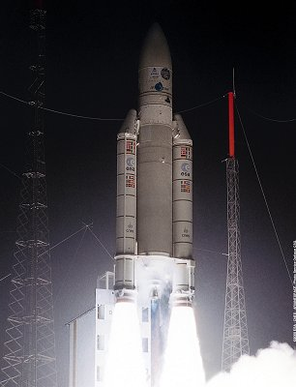
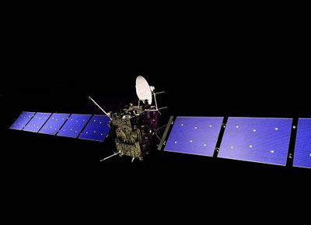
Rosetta mission
Cornerstone ESA mission launched
2 March 2004, main target is the comet 67P/Churyumov-Gerasimenko
Mars swing-by 25 February 2007 Steins fly-by 5 September 2008 Lutetia fly-by 10 June 2010 Comet rendezvous manoeuvres
22 May 2014 Lander delivery 10 November 2014 Escorting the comet around the Sun November 2014 - December 2015 End of mission December 2015

Slide 3
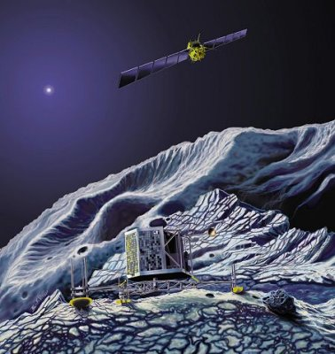
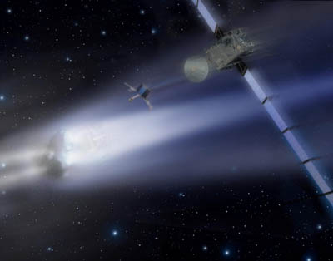
Rosetta mission
The Rosetta orbiter has eleven scientific instruments:
ALICE Ultraviolet Imaging Spectrometer
CONSERT Comet Nucleus Sounding
COSIMA Cometary Secondary Ion Mass Analyser
GIADA Grain Impact Analyser and Dust Accumulator
MIDAS Micro-Imaging Analysis System
MIRO Microwave Instrument for the Rosetta Orbiter
OSIRIS Rosetta Orbiter Imaging System
ROSINA Rosetta Orbiter Spectrometer for Ion and Neutral Analysis
RPC Rosetta Plasma Consortium
RSI Radio Science Investigation
VIRTIS Visible and Infrared Mapping Spectrometer

Slide 4
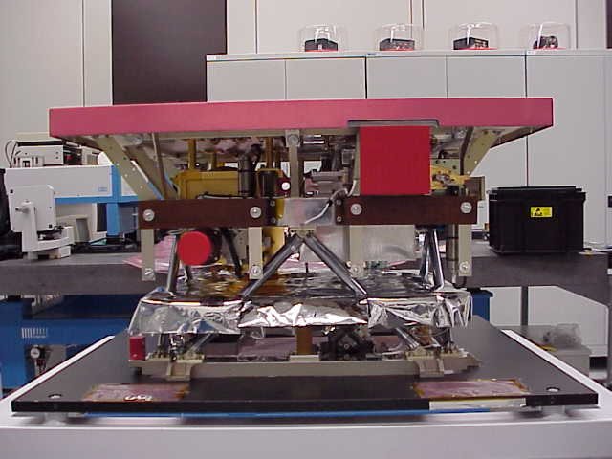
VIRTIS Visible and InfraRed Thermal Imaging Spectrometer
radiator
VIRTIS is an imaging spectrometer that combines three unique data channels in one compact instrument. Two of the data channels are committed to spectral mapping and are housed in the Mapper (-M) optical subsystem. The third channel is devoted to spectroscopy and is housed in the High resolution (-H) optical subsystem.
VIRTIS-H
S/C interface
VIRTIS-M

Slide 5
VIRTIS
The scientific objectives of VIRTIS during the Rosetta mission are:
study the cometary nucleus and its environment,
determine the nature of the solids on the nucleus surface,
identify the gaseous species,
characterise the physical conditions of the coma,
measure the temperature of the nucleus,
help with the selection of landing sites
characterise the asteroids Steins and Lutetia

Slide 6
VIRTIS
VIRTIS MAIN CHARACTERISTICS
 | VIRTIS – M Visible | VIRTIS – M InfraRed | VIRTIS - H
Spectral Range (nm) | 220.1 – 1046.0 | 952.8 – 5059.2 | Order 0 4.05-5.03 Order 1 3.47-4.32 Order 2 3.04-3.78 Order 3 2.70-3.37 Order 4 2.43-3.03 Order 5 2.21-2.76 Order 6 2.03-2.53 Order 7 1.88-2.33
Spectral Resolution λ/Δλλ | 100 – 380 | 70 – 360 | 1300-3000
Spectral Sampling (nm) (1) | 1.89 | 9.44 | 0.6
Field of View (mrad x mrad) | 63.6 (slit) x 64.2 (scan) | 63.6 (slit) x 64.2 (scan) | 0.583 x 1.749
Max Spatial Resolution (μrad) | 248.6 (slit) x 250.8 (scan)

Slide 7
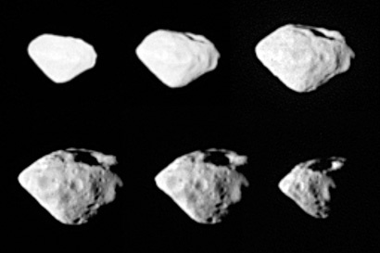
2867 Steins
Asteroid 2867 Steins was selected as a scientific target to be observed, and flown by, during the cruise phase of the Rosetta mission. The Rosetta fly-by provided a unique opportunity to perform the first in-situ exploration.
The Rosetta spacecraft flew by asteroid Steins at 18:58 UTC on 5 September 2008 at a distance of about 800 km.
Semimajor axis (AU) | 2.364
Eccentricity | 0.146
Inclination (deg) | 9.944
Taxonomic type | E
Synodical rotation period (h) | 6.06
Albedo | 0.45
Diameter | 4.6 km
OSIRIS NAC image of the asteroid Steins

Slide 8
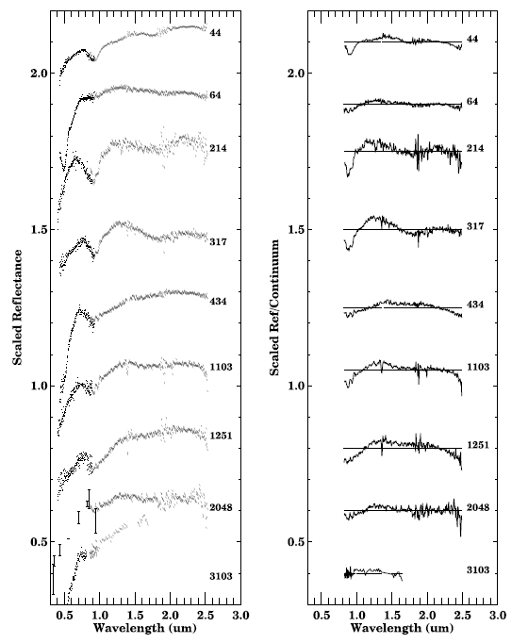
Ground based spectra of E- Type asteroids
The asteroid Steins, on the basis of ground based observation, has been classified as a rare, E-type asteroid of which little is known. E types were originally proposed to be linked to the enstatite achondrite meteorites (also known as the aubrites) by Zellner et al. [1977]
A. Coradini Rindberg-Castle 25-28 February 2009

Slide 9
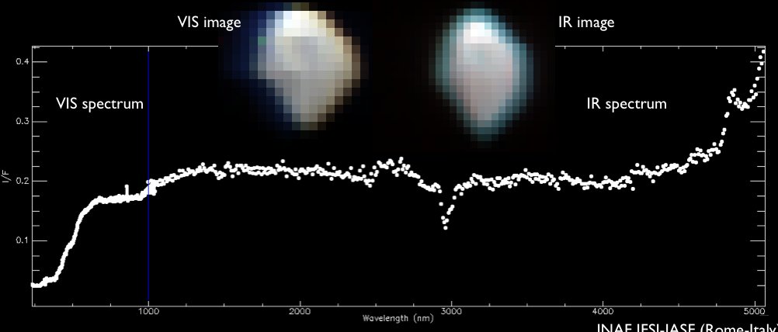
Encounter geometry
Far
Approach Phase
6.5 hours -
Light curve
Attitude
Flip Phase
20min
Asteroid Fly-By Mode and
Closest Approach Phase
45min
VIRTIS
Thermal Background
Evolution Phase
76min
Closest Approach

Slide 10
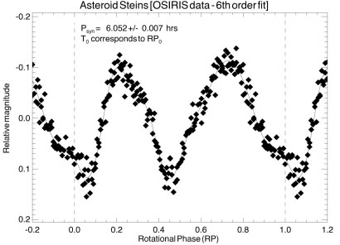
Steins lightcurve from OSIRIS

Slide 11
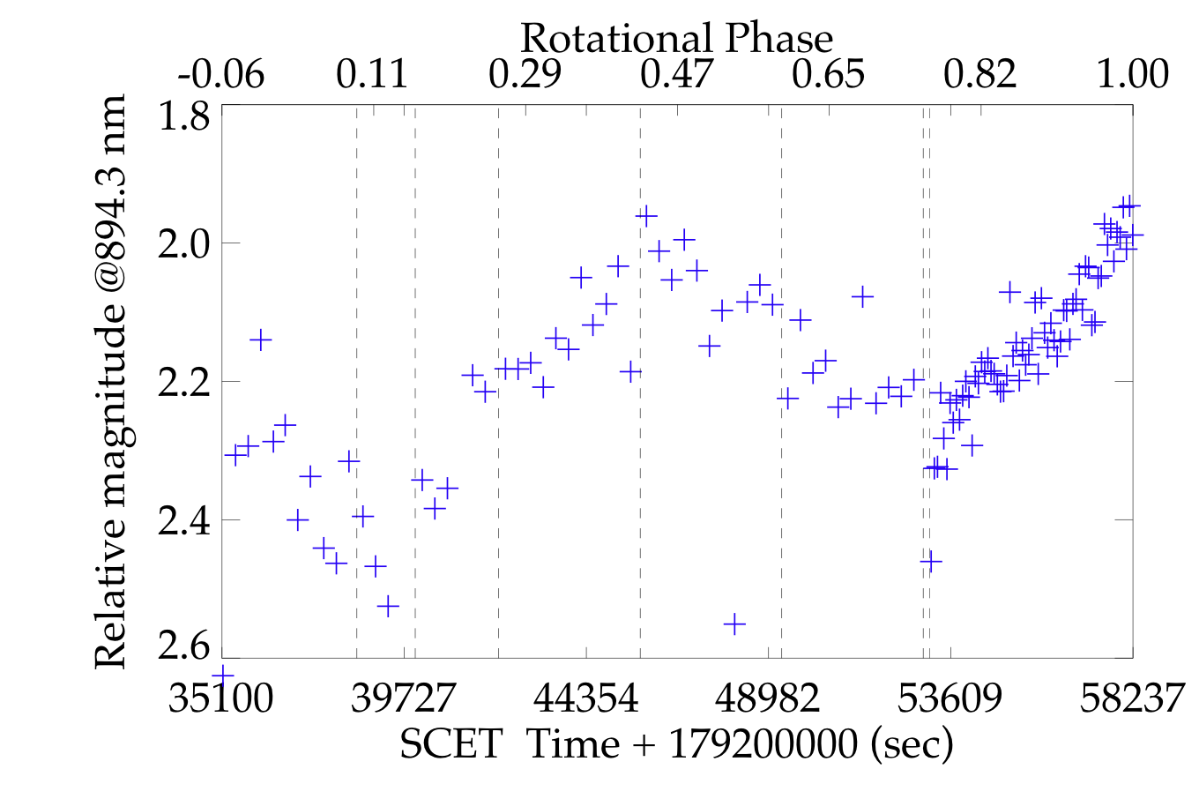
Steins lightcurve in the VIS (average of 11 bands centered at 0.894 µm)
0.431 rotational phase
Relative magnitude amplitude = 0.31
Phase interval = 0.437
Phase interval = 0.569
6

Slide 12
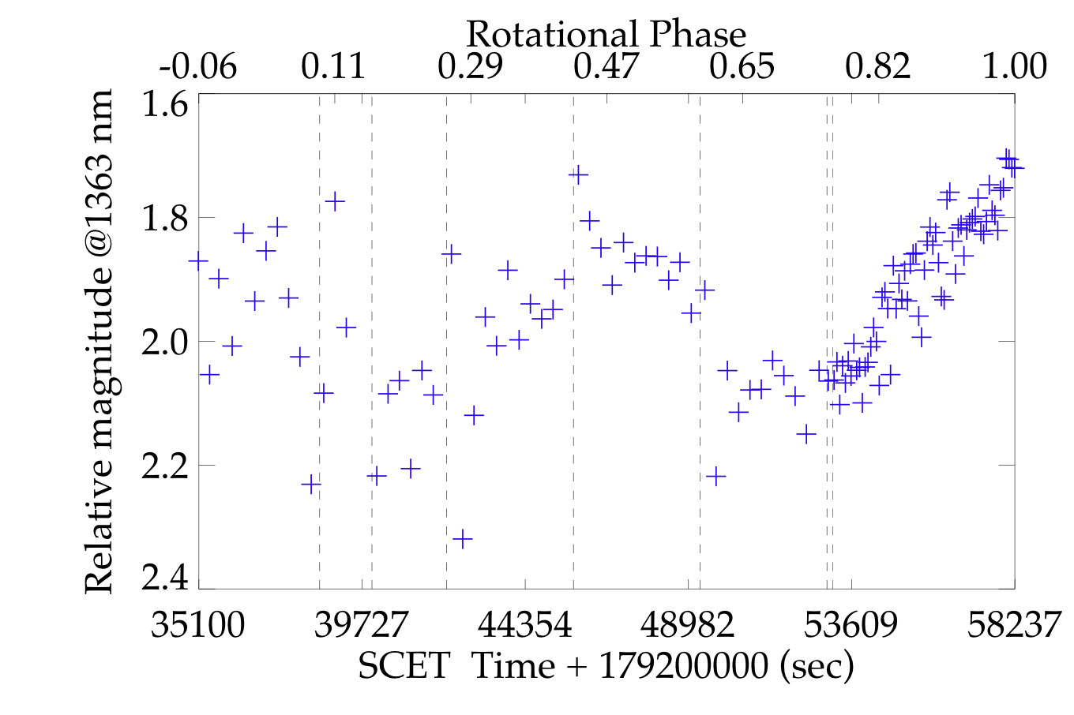
Steins lightcurve in the IR (average of 11 bands centered at 1.363 µm)
0.431 rotational phase
Relative magnitude amplitude = 0.4
Phase interval = 0.437
Phase interval = 0.569

Slide 13
Visual Reflectance Spectral Variability
Several small features can be found in the visible range .
We have applied the Brown (IEEE 2006) method to identify “stable “ signatures” based on the “derivative analysis
The 0.5 band is clearly identified
Filter Position
640-651 nm
A. Coradini Rindberg-Castle 25-28 February 2009

Slide 14
Comparison VIRTIS OSIRIS: data are normalized @ 0.63 µm
There is a discrepancy in the UV, due to low VIRTIS sensitivity and a still not satisfactory calibration →however, the signature at 0.5 µm is present in both spectra

Slide 15
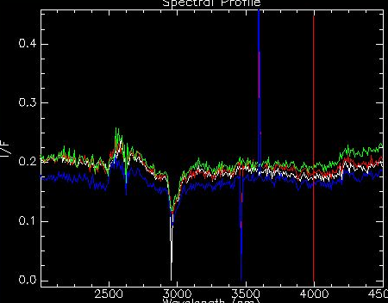
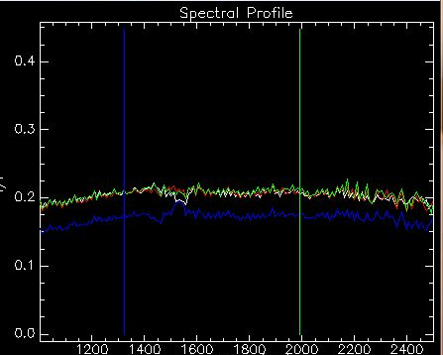
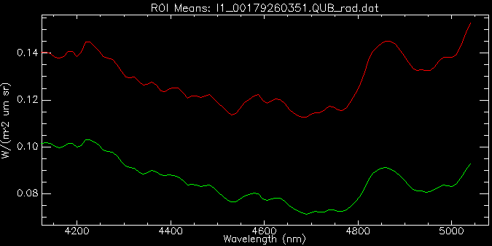
Infrared: different spectra “zones”
Zone 1 is relatively flat
Zone 2 is possibly characterized by a large band whose presence should be confirmed due to filters overlapping
Zone 3 is dominated by the thermal background on which two or more bands can be identified
The
A. Coradini Rindberg-Castle 25-28 February 2009

Slide 16
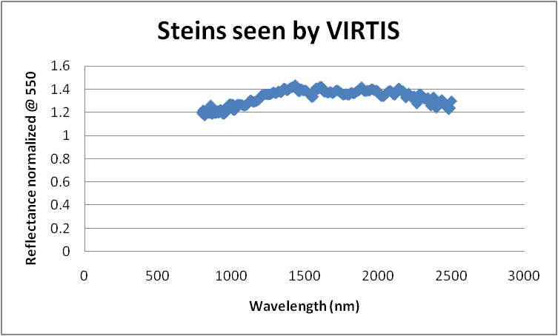
Comparison Steins – 434 Hungaria
Strong similarities are present

Slide 17
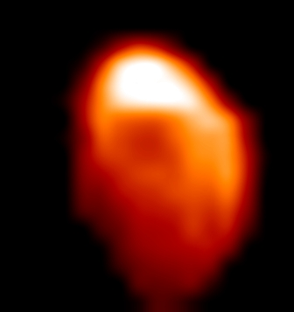
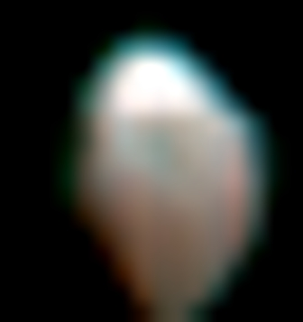
Temperature (left)and emissivity( right) Maps for ε =1
The IR region of the spectrum
In order to compute the reflectance in the IR region, the thermal contribution must be removed from the spectrum. To do that we have explored different values of the emissivity ε. The variability range of ε that brings to good results is between 0.9-1.0
Temperature map
Emissivity map
200
200-220 K
230

Slide 18
Conclusions
VIRTIS is working perfectly
The light curve is in good agreement with one obtained by OSIRIS
Preliminary analysis of VIS spectra confirms the E-type classification
Thermal infrared (3-5 µm) spectra are icompatible with an overall aubritic composition
Map of asteroid temperature obtained by VIRTIS shows a variability between 200-220 K

